Slide 1
An Analysis of
CNN and RNN
By: Javin Liu, Yuxuan Tian, Andy Li, Yintao Tai
Notes:
Hi, in this presentation we are going to show you an analysis of CNN and RNN on image classification using our models.

Slide 2
An Analysis of CNN and RNN
Method
CNN
RNN
Comparison
Andy Li
Notes:
First, we’ll go through the method of our analysis, then explain our CNN and RNN models in detail and compare the performance of the two models.

Slide 3
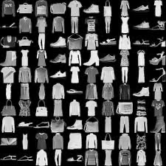
Method
Dataset
Name: Fashion-MNIST
Specification: 28*28 Greyscale
Number of Classes: 10
Training Dataset Size: 60,000
Testing Dataset Size: 10,000
Labels
T-shirt/top Trouser Pullover Dress Coat Sandal Shirt Sneaker Bag Ankle Boot
Andy Li
Notes:
We chose Fashion-MNIST as our dataset. It includes a training set of 60,000 samples and a testing set of 10,000 samples of 28 by 28 greyscale clothing images of 10 classes.

Slide 4


Method
Working Environment
IDE: Google Colab
Modeling Library: PyTorch
GitHub: https://github.com/GrayardET/MIT-Reserach
Andy Li
Notes:
We used Pytorch on Google Colab for our implementation of the networks. Then we posted all of our work to GitHub for a better collaboration experience.

Slide 5
CNN
Architecture
Improving the Accuracy
Overfitting Problem
Andy Li
Notes:
For the CNN part, I’m going to start with the architecture of our CNN, and we’ll share you some methods to improve the accuracy of our algorithm. Then, we’ll explain you some techniques we used to tackle the overfitting problem.

Slide 6
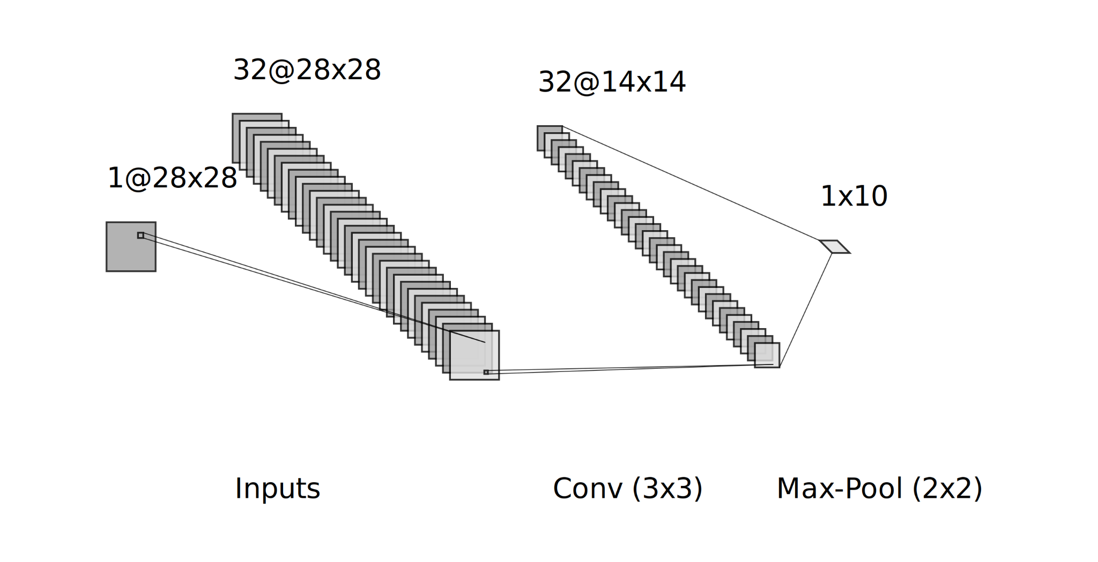
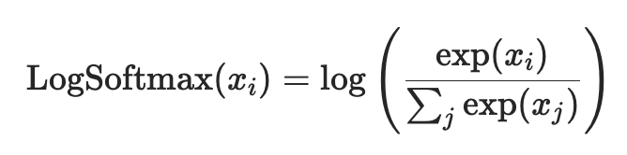
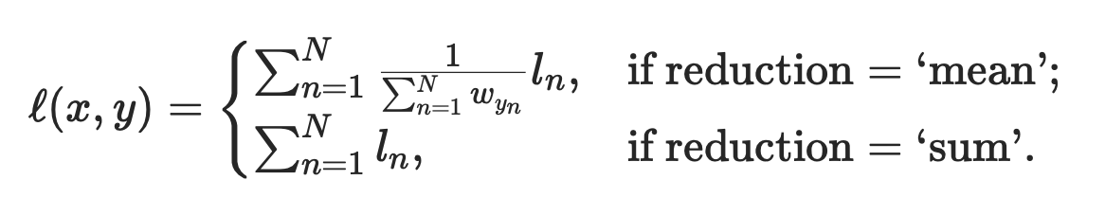
Architecture
Pooling: MaxPool
Kernel Size: 3x3
Activation Function: RELU
Loss Function: CrossEntropyLoss = Softmax + Negative Log Likelihood Loss
Conv-MaxPool
Andy Li
Notes:
We first passed our images to a 3x3 convolutional layer and then passed the layer to a 2x2 Max-Pool layer. We chose Relu as activation function and CrossEntropyLoss as our loss function.

Slide 7
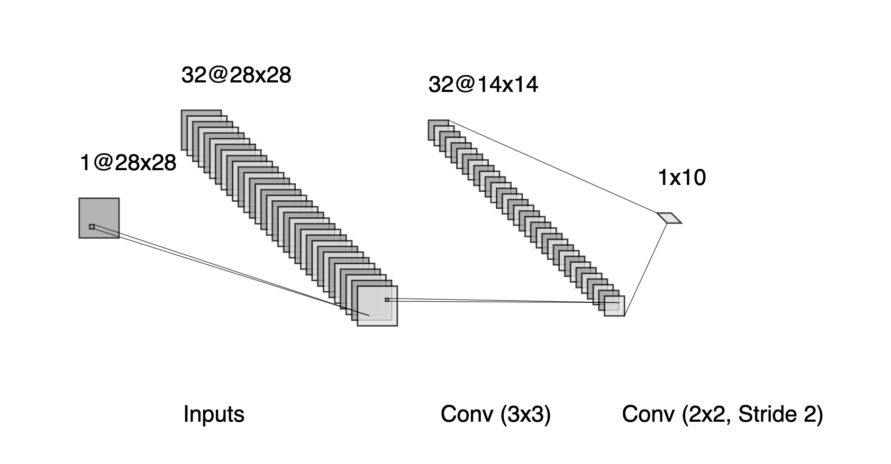
Improving the Accuracy
Conv-MaxPool
How to Downsampling?
Pooling (Max Pooling)?
Fixed function
Easier for gradients to flow through
Stride Convolution?
Flexible function
Harder for gradients to flow through
Stride-Conv
Yintao Tai
Notes:
To improve the accuracy of our model, instead of using the regular pooling layer, we replaced the Max-Pool Layer with a 2 by 2 stridden convolutional layer. It has the same effect on downsampling as max pooling layer, but more flexible because it’s a learnable function. Finally, we got an improvement on both the test and validation set.

Slide 8
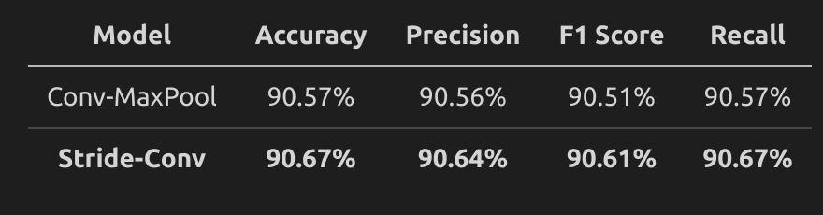
Improving the Accuracy
Conv-MaxPool
How to Downsampling?
Pooling (Max Pooling)?
Fixed function
Easier for gradients to flow through
Stride Convolution?
Flexible function
Harder for gradients to flow through
Stride-Conv
Accuracy on the test set
Yintao Tai
Notes:
To improve the accuracy of our model, instead of using the regular pooling layer, we replaced the Max-Pool Layer with a 2 by 2 stridden convolutional layer. It has the same effect on downsampling with max pooling, but more flexible because it’s a learnable function. Finally, we got an improvement on both the test and validation set.

Slide 9
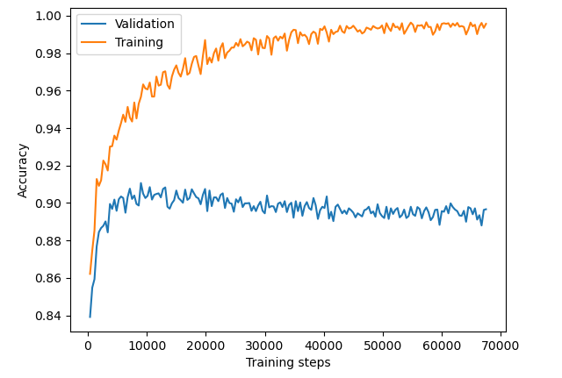
Overfitting Problem
Training process of Stride-Conv
The accuracy is too high on Training set!
99.93%
But much lower on the Validation set
91.38%
Yintao Tai
Notes:
However, the accuracy on the validation set is much lower than on the training set. As you can see on the right hand side, as the training progresses, the accuracy on the Training set keeps improving but it begins to decrease on the validation sets. The model overfitted the training set.

Slide 10
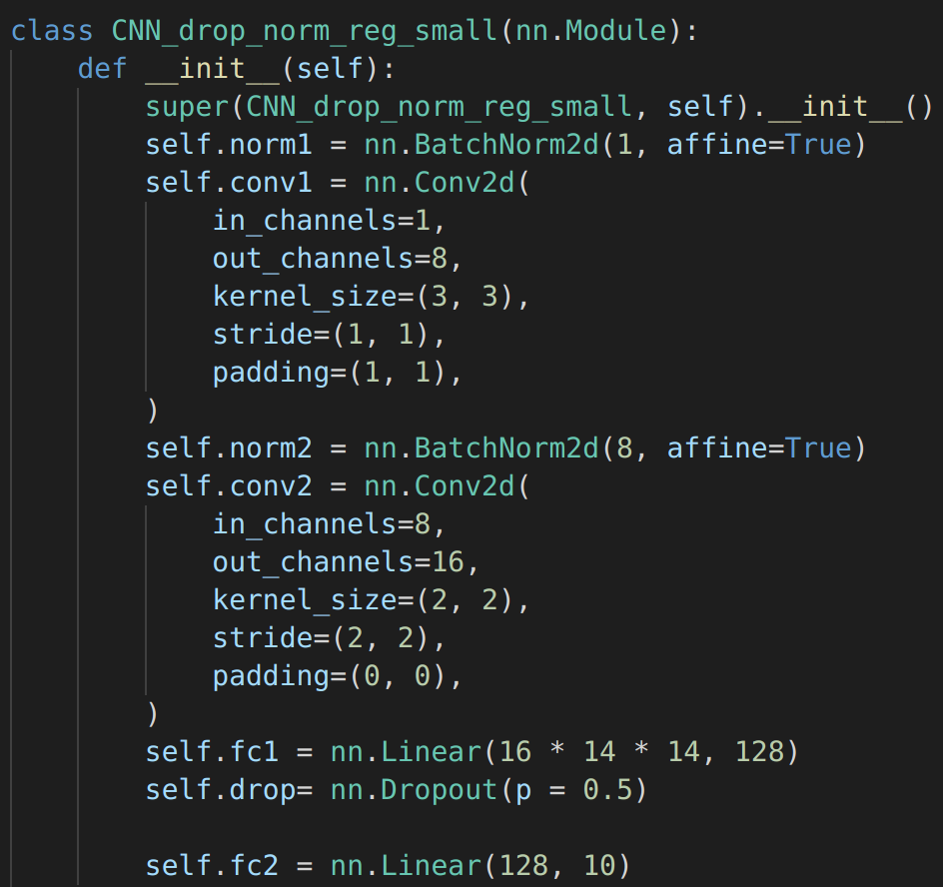
Overfitting Problem
Add Dropout layer
Random drop out nodes of FC layer
Add noise to the training process
Batch Normalization & Regularization
Decrease bias each layer produced
Each layer can learn independently
L2 Regularization
Reduce Complexity
Don’t let the net remember the dataset!
Yintao Tai
Notes:
We tried several ways to manage this problem. Firstly, we add dropout layers after the linear layer. The dropout layer randomly sets some nodes’ output as 0, by this way it adds noises into the training process. So the model could be more general. Secondly, we applied batch normalization between convolution layers. It can reduce the biases produced by each layer, so each layer can learn more independently. Also, we reduced the model Complexity. Instead of using 32 filters, we find 8 filters are enough for this task, and reducing the number of parameters could reduce the model’s memory of training data.

Slide 11
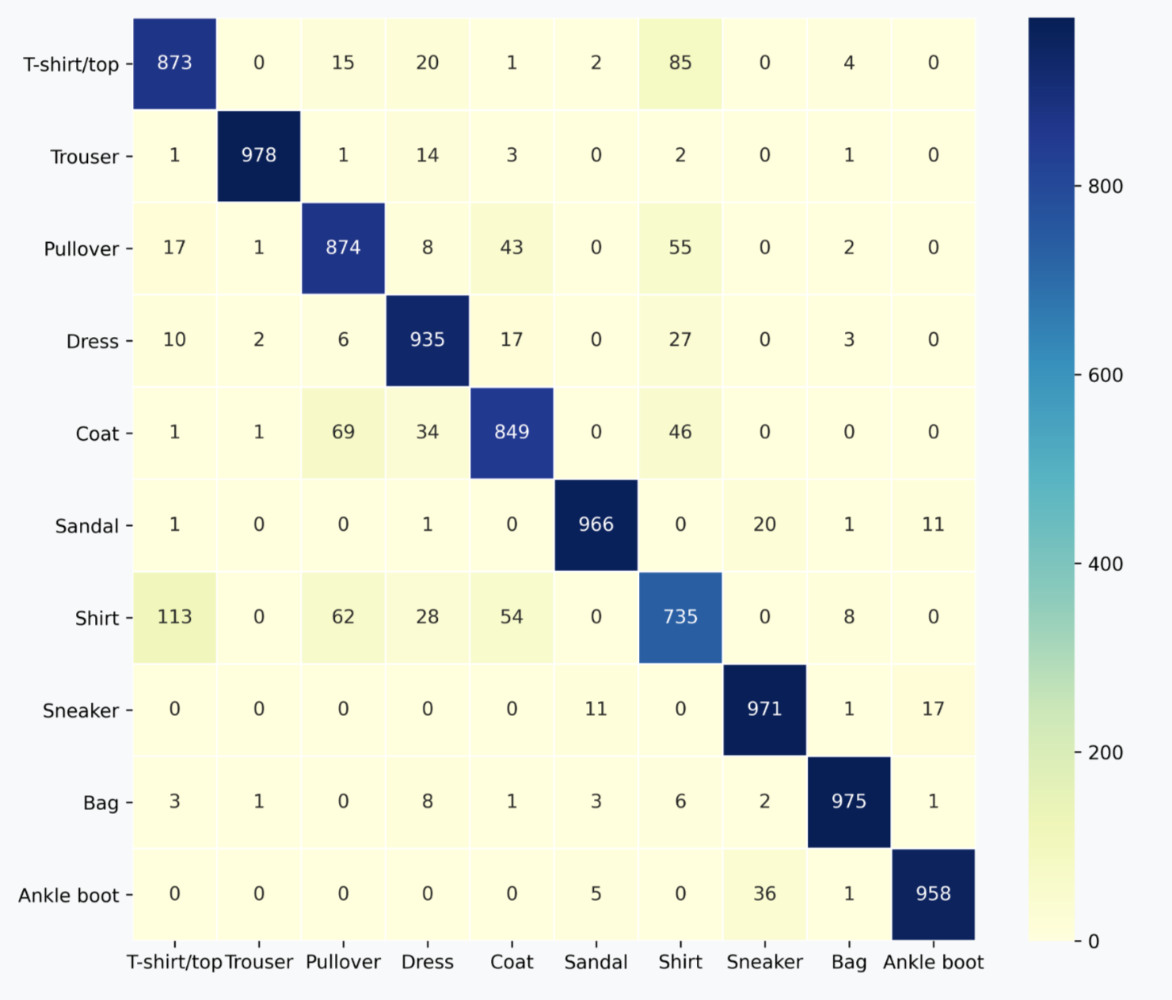
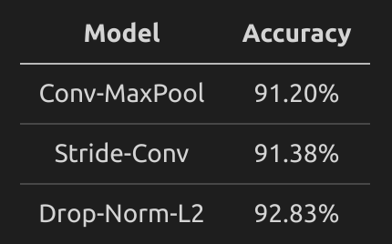
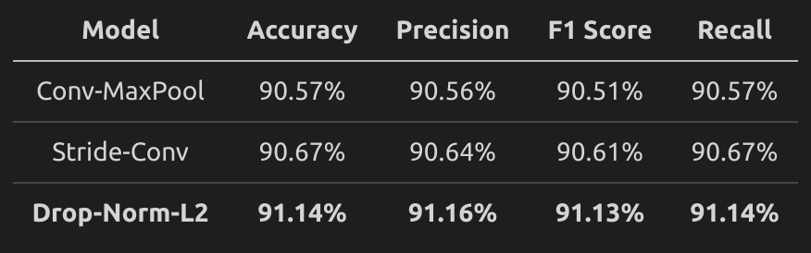
CNN Results
Yintao Tai
Drop-Norm-L2 Confusion Matrix - Test Set
Accuracy on Validation Set
Performance on Test Set
Notes:
By doing this we further increased the CNN performance. Let’s see the final results of CNNs. The three models here are the beginning model with Max Pooling, the improved model with Stridden Convolutional layer and the final model with Dropout and batch normalisation. The final model has the best performance in terms of all the metrics. The right hand side is the the confusion matrix. The diagonal is correctly classified images. We can find out the model often incorrectly classify Shirt as T-shirt or classify T-shirt as Shirt. It’s intuitive Because T-shirts and Shirts look similar to each other.

Slide 12
RNN
Architecture
Stats
Notes:
In this section we’ll give a brief recap of the RNN data structure and how it’s applied on the Fashion MNIST dataset for image classification.(yuxuan)

Slide 13

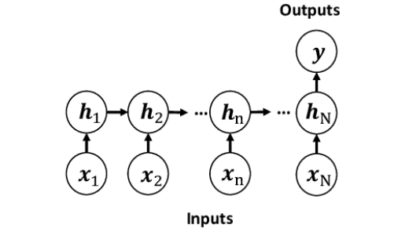
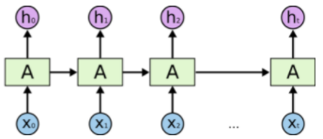
RNN Architecture
A RNN is similar to an NN except that it is like a repeated nn that gets copied multiple times. This structure is useful for dealing with sequences and lists.
Notes:
We have seen many-to-many RNN structure before, where the model computes an output at every time step. When performing a classification task, we can simply modify the model to a many-to-one model by only computing an output at the very last time step.(Yuxuan)

Slide 14
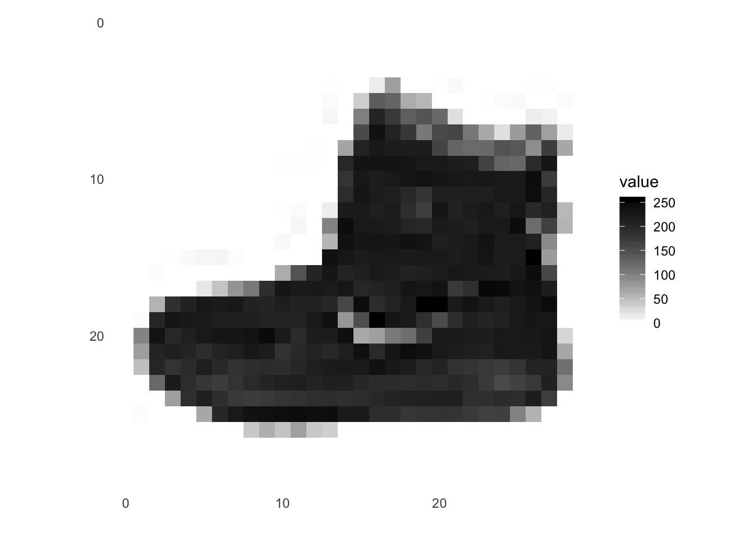
How is the RNN Used for image processing
Similar to an sequence we take an image data set and for each image we use the image.view function to convert the image to a tensor that we pass into the RNN. We scale the values to a value between 0 and 1. Since this tensor is an sequence of numbers, we can use an RNN to perform image classification on it.
input value x
Time
Notes:
RNN is known for processing sequential data with time, but it can also be applied on image datasets. We input one row of the image into the model at every time step from top to bottom, as if the model learns to predict by reading the image one row after another.
Since the resolution of images in the Fashion Mnist dataset is 28 by 28, the input dimension for each time step is(1x28), and the sequence length is also 28. Then the hidden state of the final time step gets passed to a fully connected network to make the final prediction. (Yuxuan)

Slide 15

Stats of RNN
Training Speed
Accuracy: The RNN had an average evaluation accuracy of around 81.75% and an average training accuracy of around 82.54%.
Notes:
K-fold Cross Validation is a training method that usually allows a more general interpretation of the model’s expected performance. We applied 5-Folds Cross Validation with minibatch size of 64 on the RNN. This gives us an average evaluation accuracy of around 81.75% and an average training accuracy of around 82.54%.(Yuxuan)

Slide 16
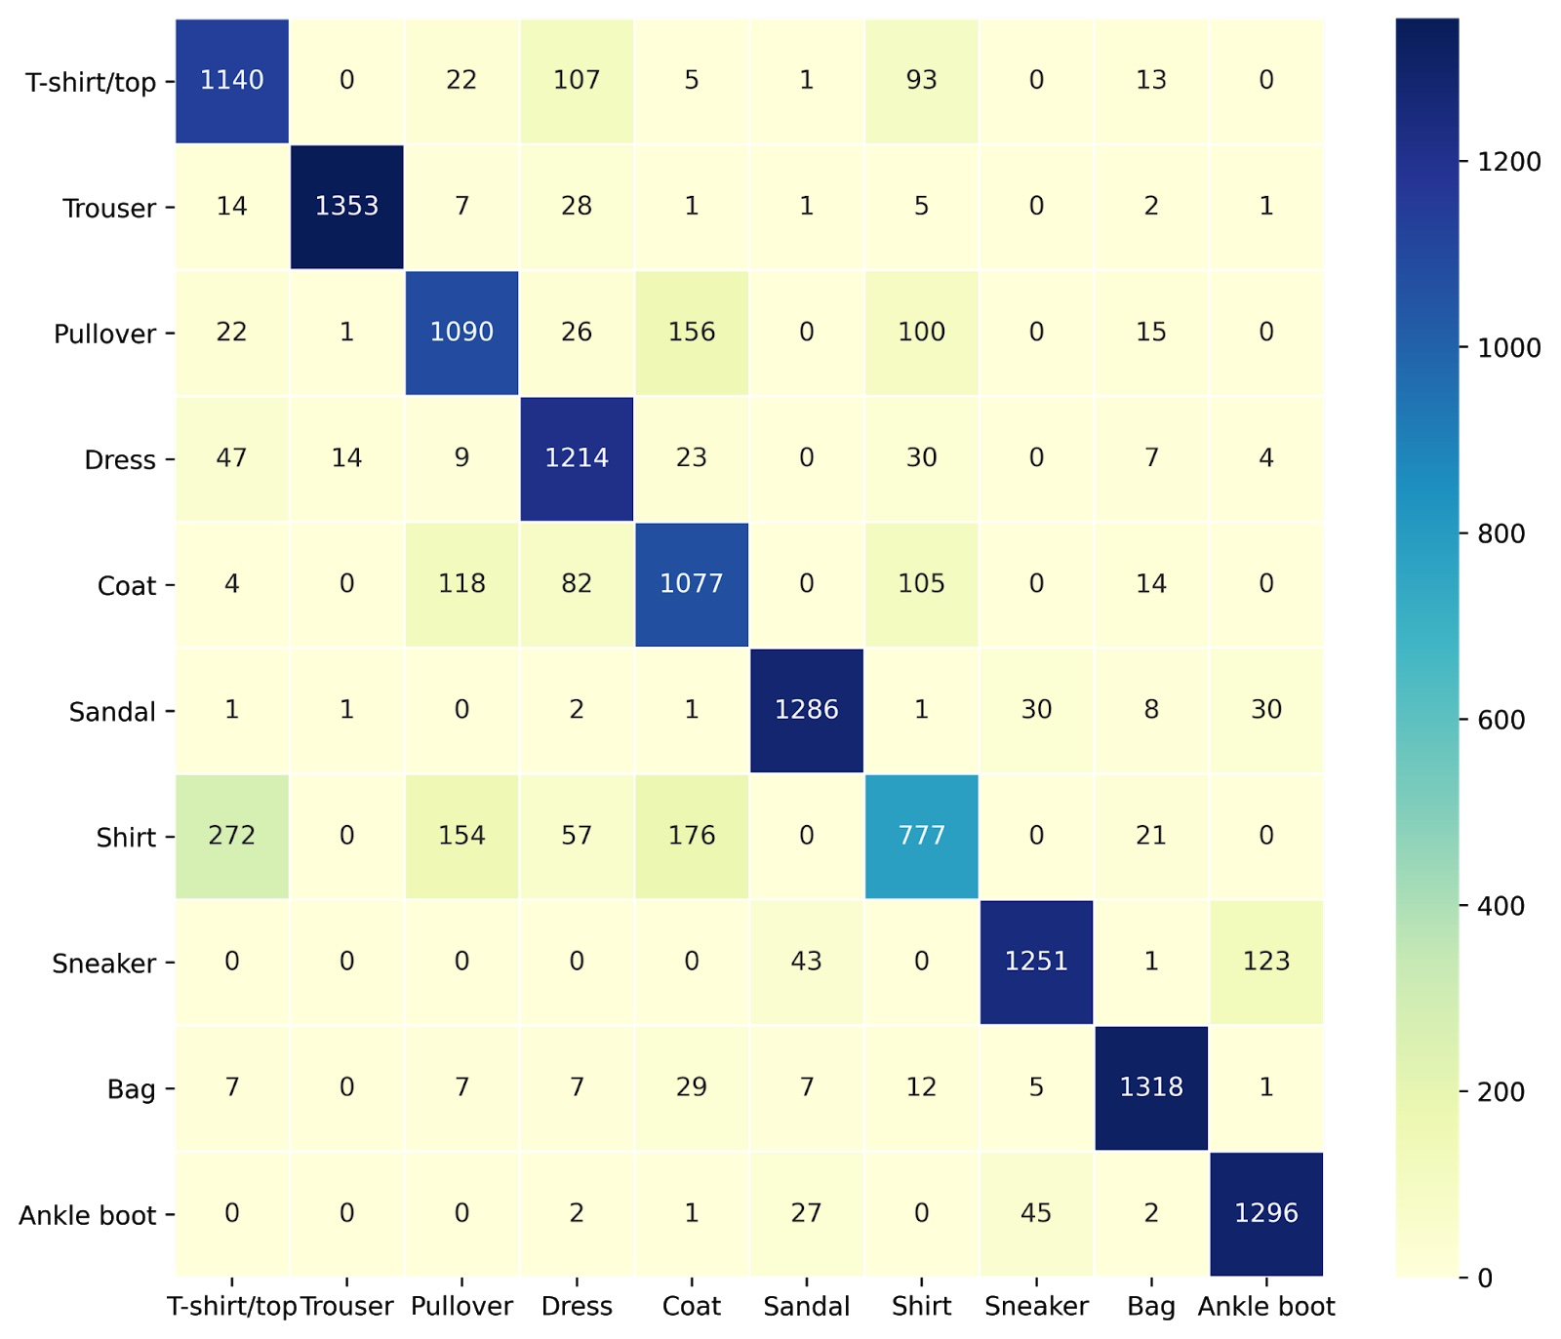
RNN Confusion Matrix
Notes:
The confusion matrix shows again that shirts are easily misclassified as T-shirts.
RNN isn’t the best recurrent model for image classification, since it can easily run into the vanishing gradient problem with the the training sequence being too long. But this is an issue that can be addressed by LSTM.(Ethan)

Slide 17
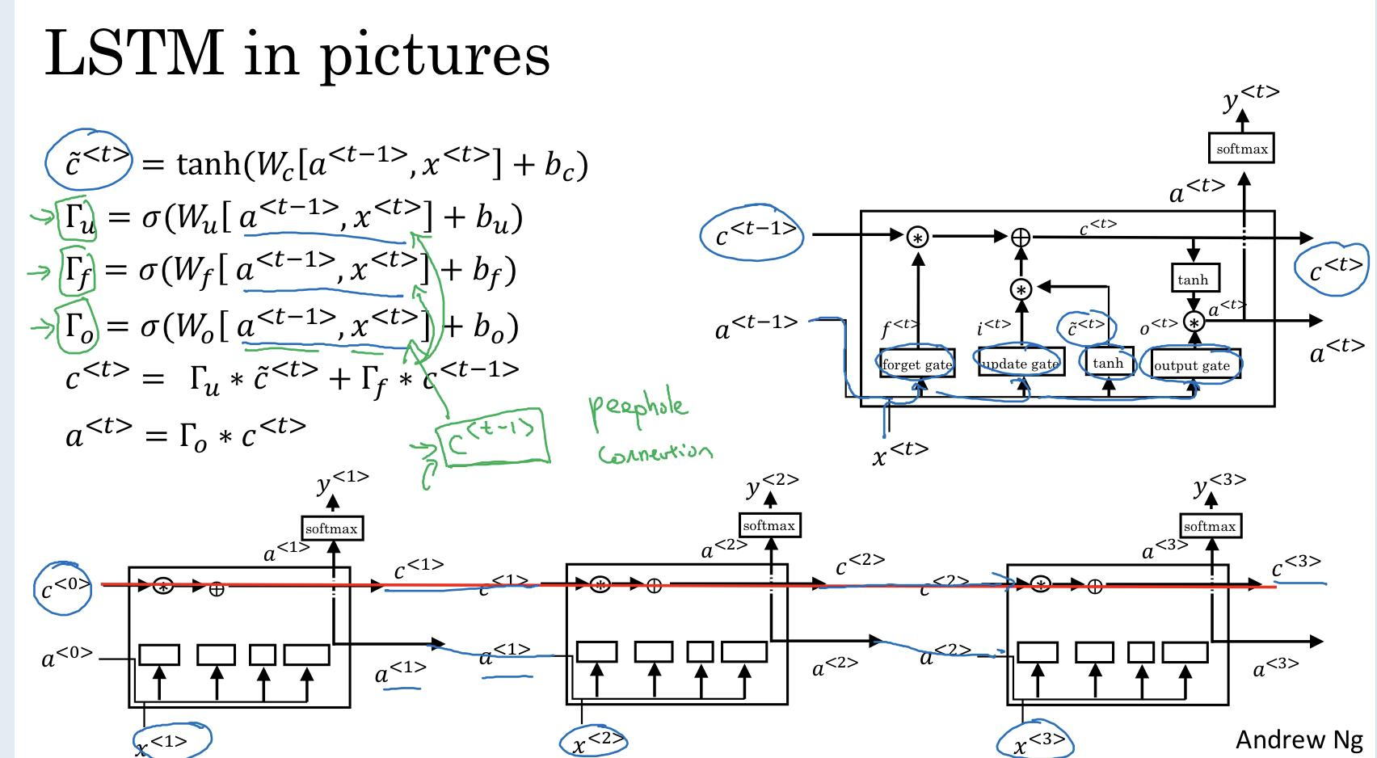
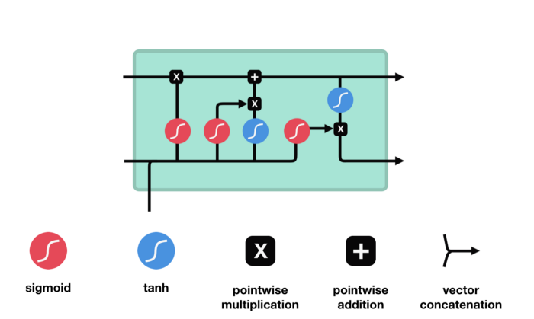
LSTM Explained (Skip because of time constraint)
From Deeplearning.ai Course 5
Notes:
On the left is the equations used in the LSTM. We will skip the next few slides because of time restraints. Javin if necessarily)

Slide 18
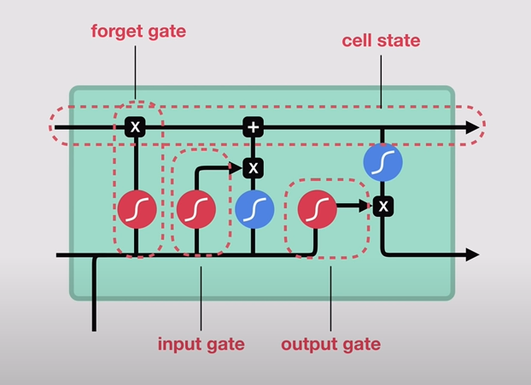
LSTM Components (Skip because of time constraint)
Notes:
The LSTM have 4 components that provides us with the short term feature. The gates are the forget gate, input gate, output gate.

Slide 19
LSTM Step 1: Pass Info to the forget gate
(Skip because of time constraint)
Notes:
We take a output from the previous hidden state (ht-1) and then we take the input of our current state Xt and combine them to form a vector. We pass this to an activation function (sigmoid function which makes sure the number is below 0 and 1). We forget values coming out if the sigmoid is closer to 0 and vice-versa. The blue circles in the graph are tanh activation functions and the red circles are the tan functions. The reason why we want to use tan is because it helps us regulate the NN to prevent the values from getting too large. Tan keeps them from -1 to 1.

Slide 20
LSTM Step 2: Pass info to the input gate
(Skip because of time constraint)
Notes:
We pass the same vector combination of the ht-1 and Xt to the other activation functions. We multiply the output of the sigmoid and tangent and pass it to the forget gate. The multiplication acts as a forget gate and the sigmoid decides what parts of the tanh output we keep.

Slide 21
LSTM Step 3: Calculate Candidate
(Skip because of time constraint)
Notes:
We calculate the candidate by adding together the forget gate output and the input gate output. This essentially serves as the input to the next sequence.

Slide 22
LSTM Step 4: Pass into output Gate
(Skip because of time constraint)
Notes:
The same initial vector we passed to the other two gates is passed to the output gate which applies the tangent function to the initial vector and sigmoid to the candidate (which is the addition of the outputs from the input gate and forget gate). We then multiply the output of the two activation functions and the pass the hidden state out to the next section of the LSTM sequence. This essentially decides what info we keep and discard in our hidden state output. This hidden state output acts as the memory which contains info about the past sequences which is useful for predictions.

Slide 23
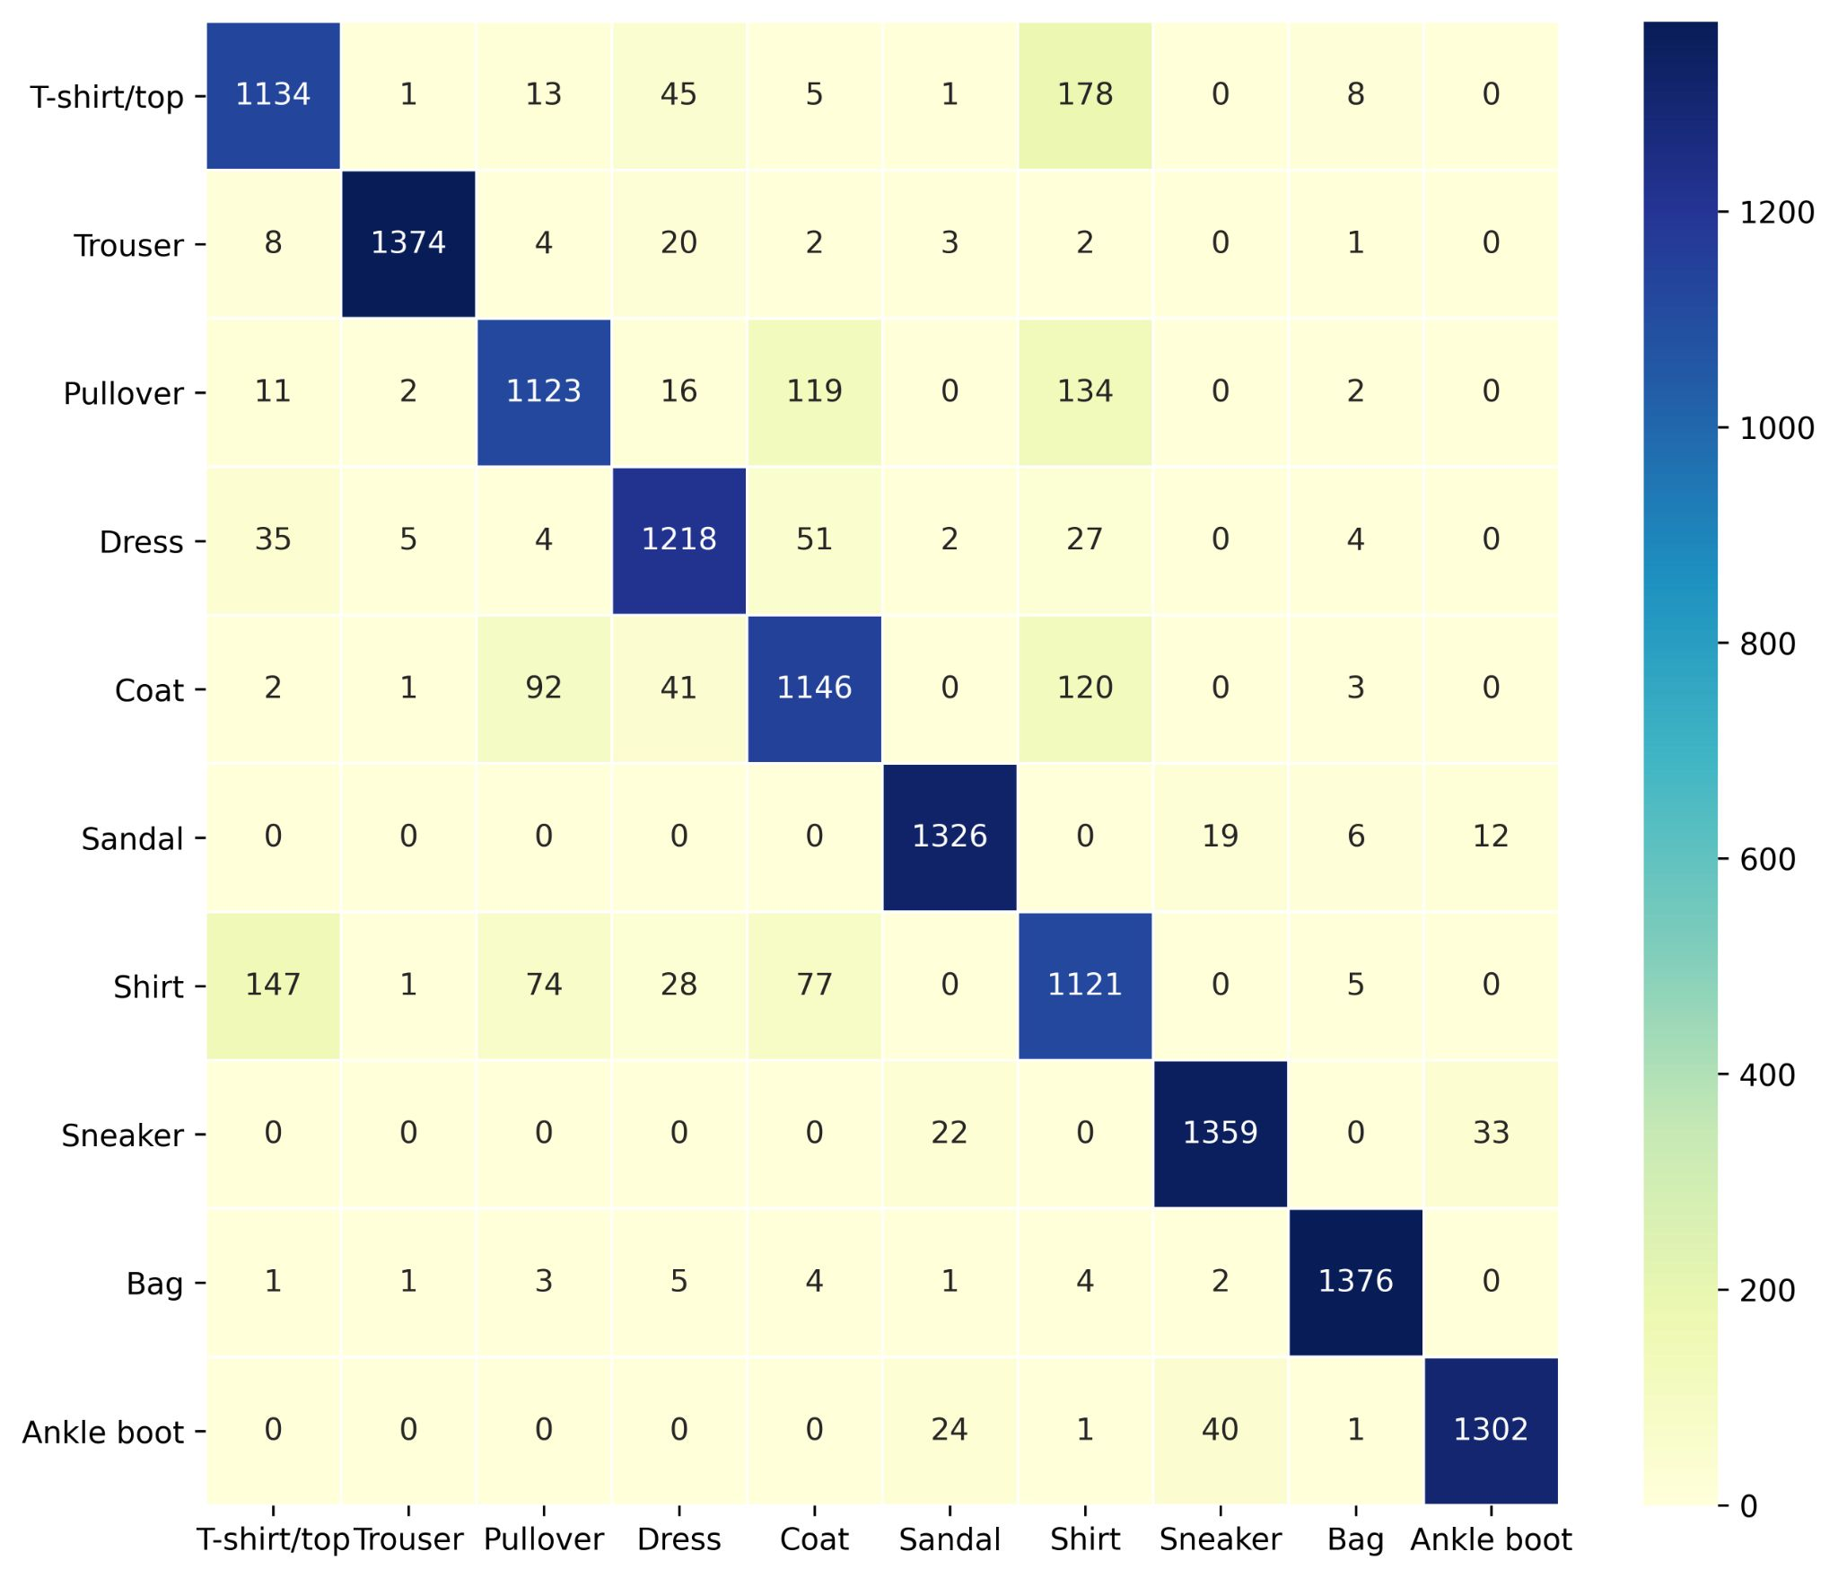
LSTM Confusion Matrix
Notes:
We also plotted the confusion matrix for the LSTM model. The numbers in the diagonal is larger than the numbers in the RNN confusion matrix. This means that LSTM correctly classifies more images than RNN. (Javin)

Slide 24
Stats of LSTM
The LSTM had an average evaluation accuracy of around 88.4375% and an average training accuracy of around 88.931%.
Notes:
Using K-Folds Cross Validation on the LSTM with 5 folds, we achieved a better average of around 88.4 percent and 88.93 when compared to the RNN performance. (Javin)

Slide 25
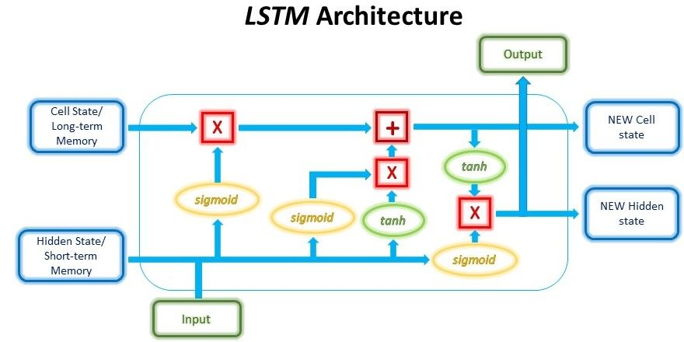
Analysis of results and explanation
We see that a LSTM performs better in general. We believe that this is due to the added gates in an LSTM and the Long short term memory feature of the LSTM that helps us classify the images of the Fashion MNIST better.
Notes:
As we stated in the previous slide, the LSTM performs better in general. This is because of the added gates in an LSTM allows it to remember past info better than a regular RNN. A RNN has a really short memory which is not ideal for long sequences. LSTM improves on that. (Javin)

Slide 26
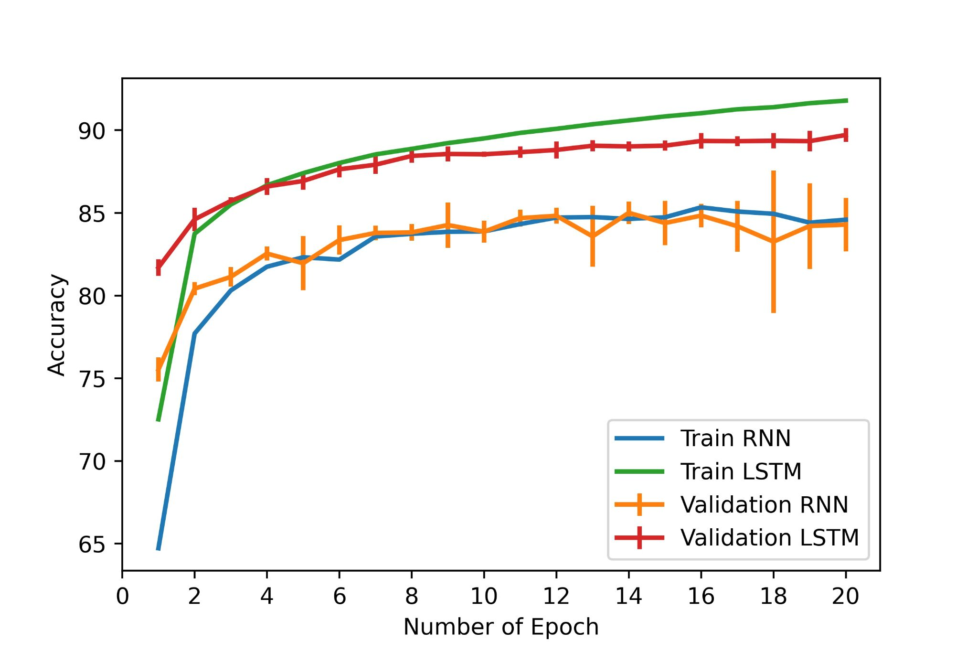
Comparison
From our tests, we see that LSTM outperforms RNN in terms of accuracy.
Notes:
We performed 5-fold cross validation for both RNN and LSTM and plotted the validation accuracy with standard deviation. From the graph, we can see that LSTM not only outperforms RNN by a significant margin, but is also provides a lot more consistency. (Javin)

Slide 27
Comparison
Accuracy
CNN:
91.14% best test accuracy
(by Drop-Norm-Conv)
RNN:82.52% average test accuracy
LSTM: 88.931% average accuracy
Yintao Tai
Notes:
We see that the CNN outperformed RNN and LSTM. This agrees with our hypothesis. But RNN and LSTM also have accuracy. That’s because we feed image data to it line by line, it can interpret vertical spatial information. But CNN structure can interpret both vertical and horizontal information, by this nature, it should has better performance on image classification tasks. (Yintao)

Slide 28
Thanks !
Any questions?
Notes:
Thanks! That’s all for today’s presentation. Any questions?

Slide 29
Citations
Brownlee, Jason. “Deep Learning CNN for Fashion-MNIST Clothing Classification.” Machine Learning Mastery, 27 Aug. 2020, machinelearningmastery.com/how-to-develop-a-cnn-from-scratch-for-fashion-mnist-clothing-classification/.
Classification (CNN, LSTM) Data Set Based on Pytorch of Mnist - Programmer Sought, www.programmersought.com/article/48502132499/.
Elvis. “Building RNNs Is Fun with PyTorch and Google Colab.” Medium, Dair.ai, 28 Feb. 2020, medium.com/dair-ai/building-rnns-is-fun-with-pytorch-and-google-colab-3903ea9a3a79.
Phi, Michael. “Illustrated Guide to LSTM's and GRU's: A Step by Step Explanation.” Medium, Towards Data Science, 28 June 2020, towardsdatascience.com/illustrated-guide-to-lstms-and-gru-s-a-step-by-step-explanation-44e9eb85bf21.
Oberoi, Archna. “CNN vs. RNN: What's the Difference?” Your Technology Partner for Software Engineering, Daffodil Software, 13 Aug. 2020, insights.daffodilsw.com/blog/cnn-vs-rnn-whats-the-difference.
Oberoi, Archna. “CNN vs. RNN: What's the Difference?” Your Technology Partner for Software Engineering, Daffodil Software, 13 Aug. 2020, insights.daffodilsw.com/blog/cnn-vs-rnn-whats-the-difference.
“Illustrated Guide to LSTM's and GRU's: A Step by Step Explanation.” YouTube, YouTube, 19 Sept. 2018, www.youtube.com/watch?v=8HyCNIVRbSU.
“Long Short Term Memory (LSTM) - Recurrent Neural Networks.” Coursera, www.coursera.org/learn/nlp-sequence-models/lecture/KXoay/long-short-term-memory-lstm.
“RNN¶.” RNN - PyTorch 1.9.0 Documentation, pytorch.org/docs/stable/generated/torch.nn.RNN.html.
“LSTM¶.” LSTM - PyTorch 1.9.0 Documentation, pytorch.org/docs/stable/generated/torch.nn.LSTM.html.

